Slide 1





1 2m 00m 2020 00e 40
Gor Sargsyan GT obaT A & E kon oni Strateji Su n u nu
fi T ee ///#e /U sers/ASU S/Desktop/projects/Gor su n u n/su n u nm h tn T

Slide 2








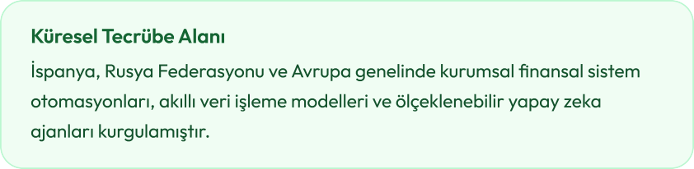
1 2m 06m 2026 06e 46
Gor Sargsyar Gi obai A & E korom Stratej Su ru mu
•
f i ee ///#e /U sers/ASU S/Desktop/projects/Gor su ru m/su ru m m h tm i

Slide 3













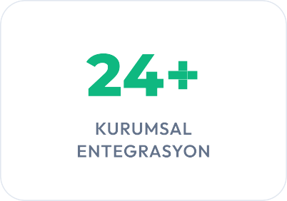
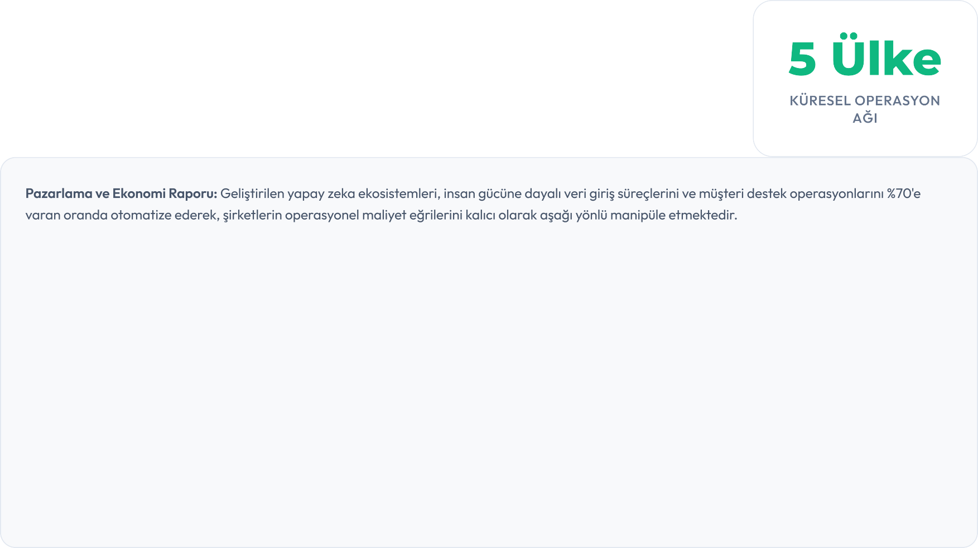

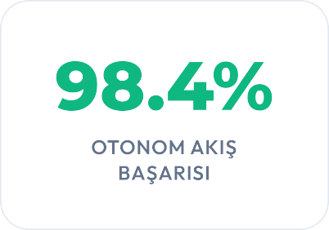

1 2m 06m 2026 06e 46
Gor Sargsyan Gm obam A & E kon om Stratej Su n u mu
f m ee ///#e /L sers/ASL S/Desktop/projects/Gor su n u m/su n u m m t tm m

Slide 4













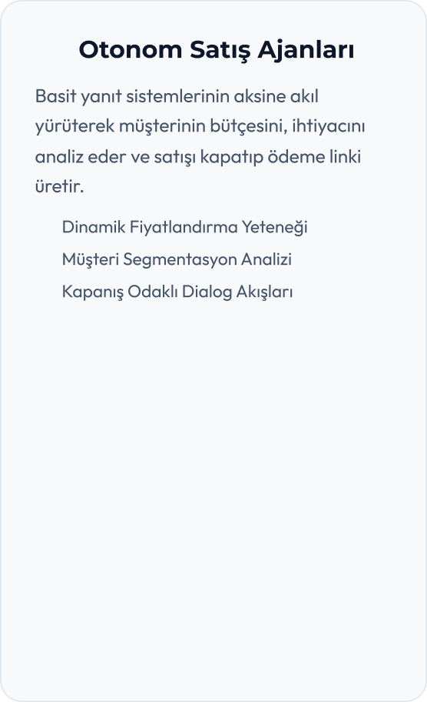
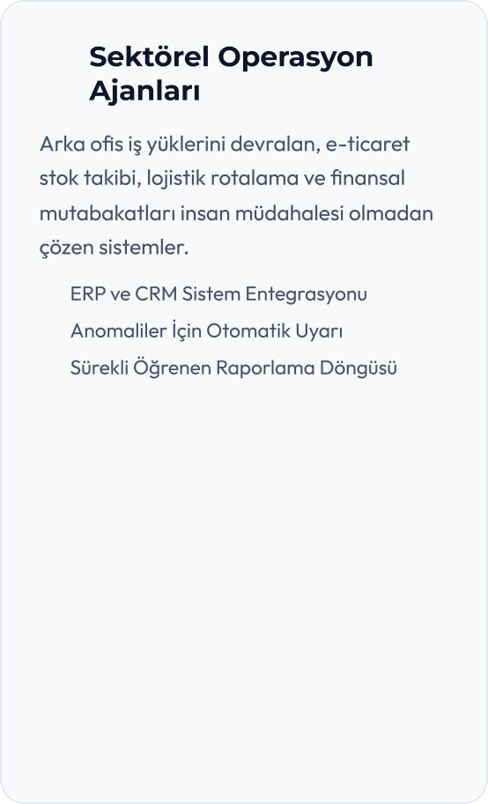
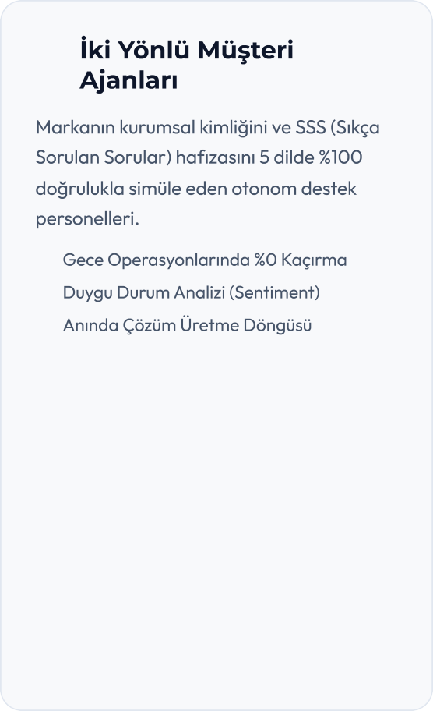
1 2m 06m 2026 06e 46
Gor Sargsyan Gm obam A & E kon orr i Strateji Su n u rru
�
� | � | �
� | � | �
 | � | �
fi m ee ///'e /U sers/ASU S/Desktop/projects/Gor su n u rr /su n u rr m h trr m

Slide 5








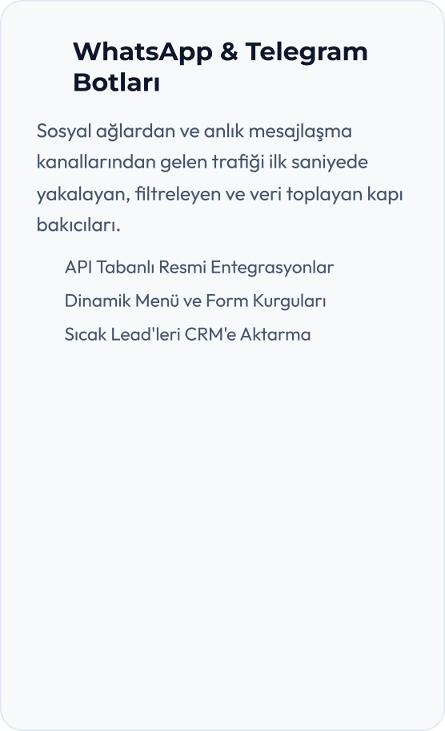
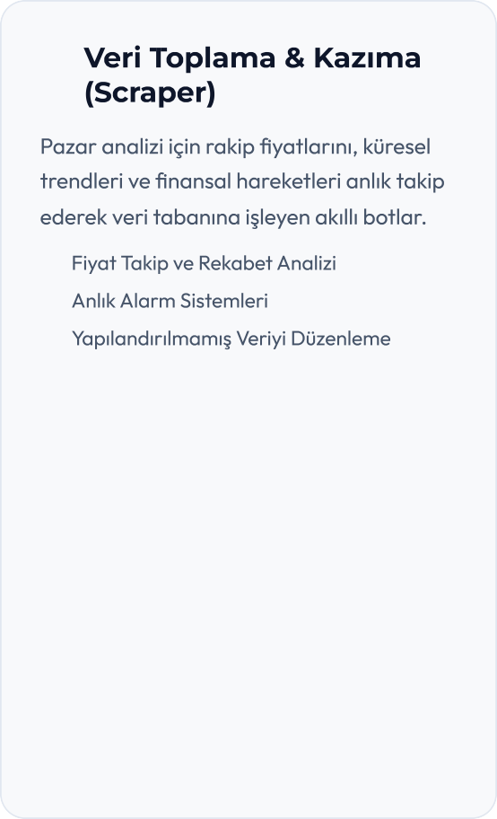
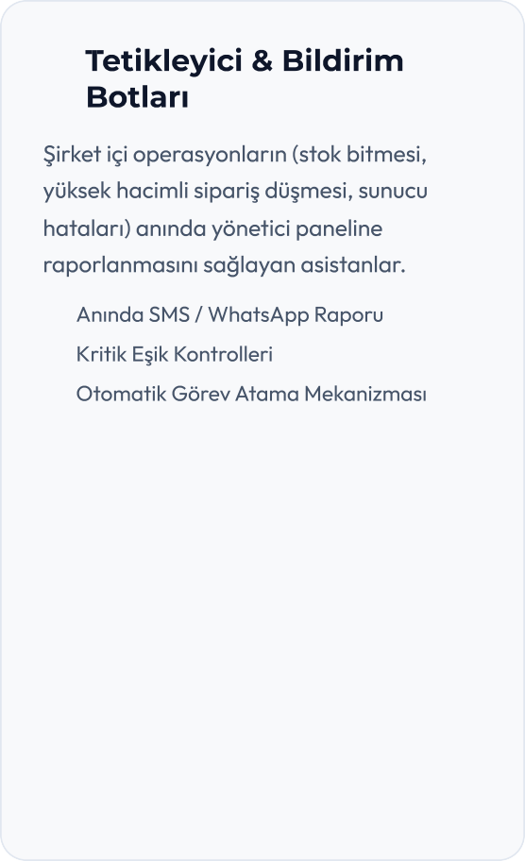
1 2m 06m 2026 06e 46
Gor Sargsyar Gi obai A & E korom Stratej Su ru mu
 | �
� | � | �
� | � | �
� |  | �
f i ee ///'e /U sers/ASU S/Desktop/projects/Gor su ru m/su ru m m h tm i
-/1 2

Slide 6

















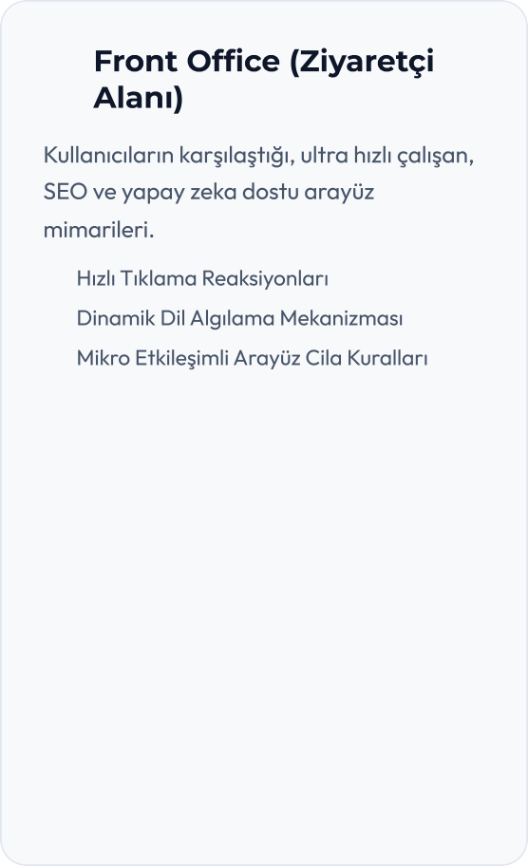
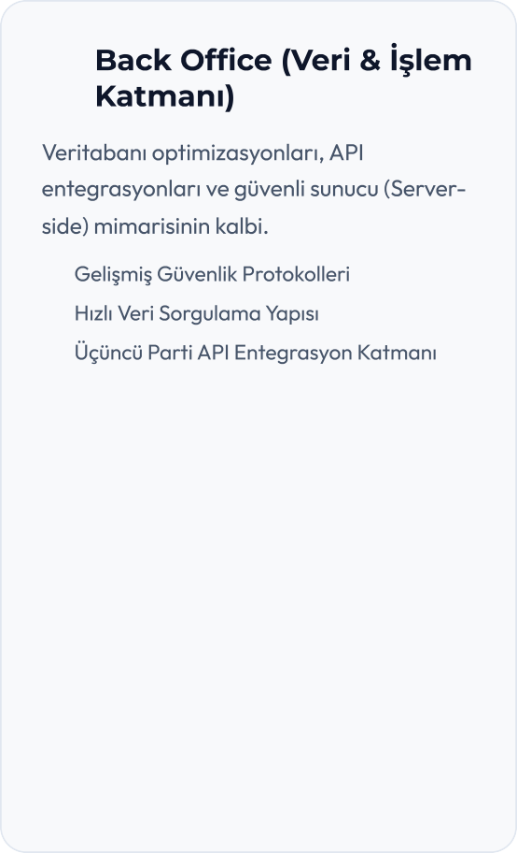
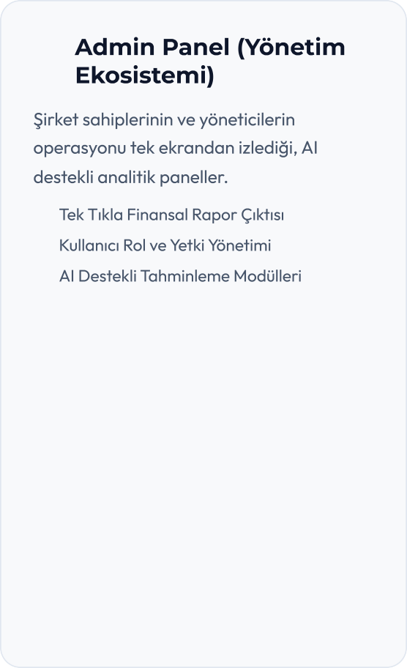
1 2m 06m 2026 06e 46
Gor Sargsyar Gi obai A & E korom Stratej Su ru mu
-
f i ee ///'e /U sers/ASU S/Desktop/projects/Gor su ru m/su ru m m h tm i
6/1 2

Slide 7










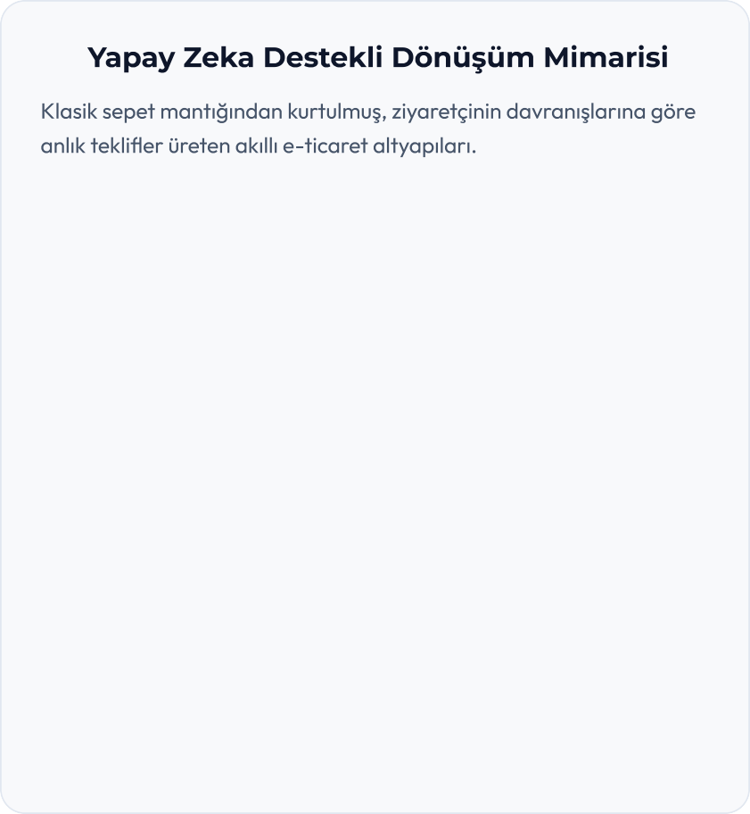


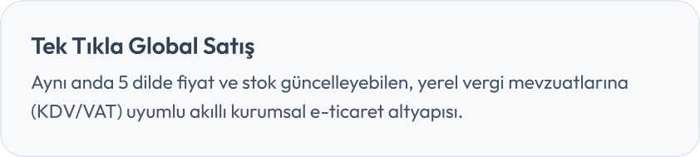
1 2m 06m 2026 06e 46
Gor Sargsyar Gi obai A & E korom Stratej Su ru mu
�
�
�
f i ee ///%e /U sers/ASU S/Desktop/projects/Gor su ru m/su ru m m h tm i
+/1 2

Slide 8




















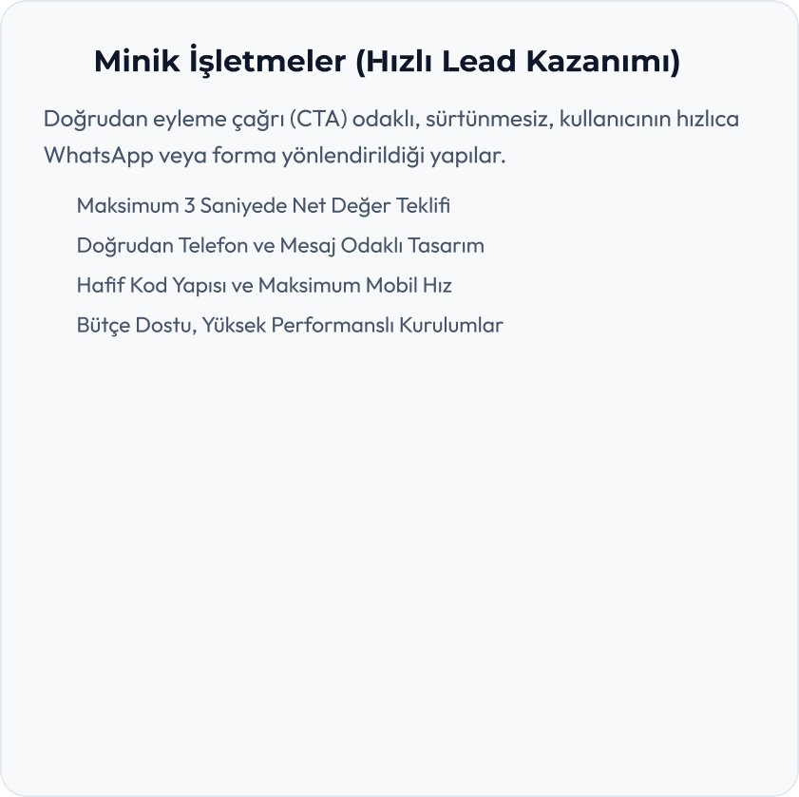
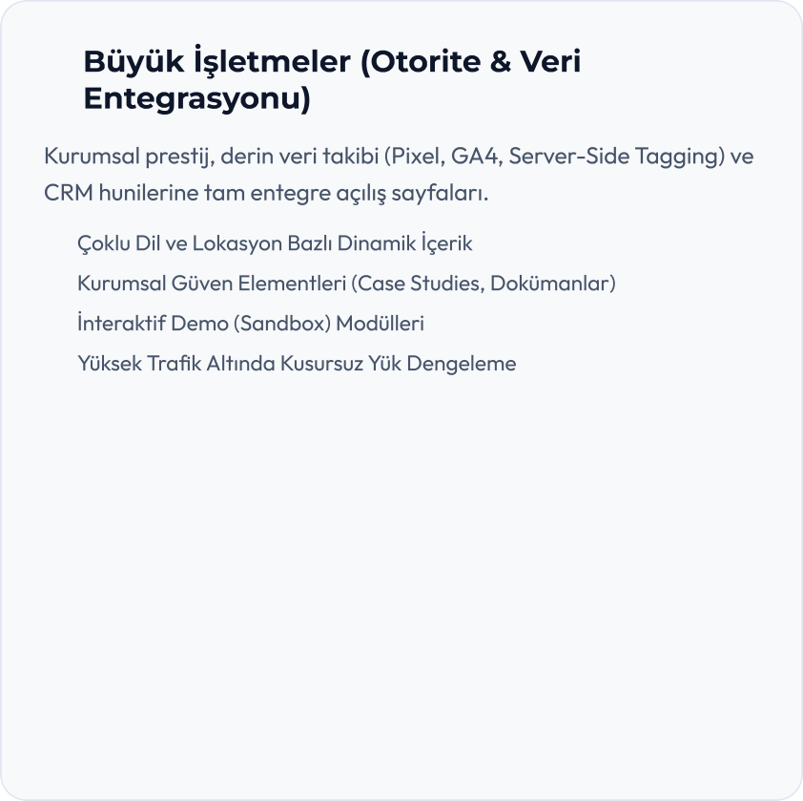
1 2m 06m 2026 06e 46
Gor Sargsyar Gi obai A & E korom Stratej Su ru mu
ı...
�
�
�
�
�
�
�
�
f i ee ///&e /U sers/ASU S/Desktop/projects/Gor su ru m/su ru m m h tm i
,/1 2

Slide 9











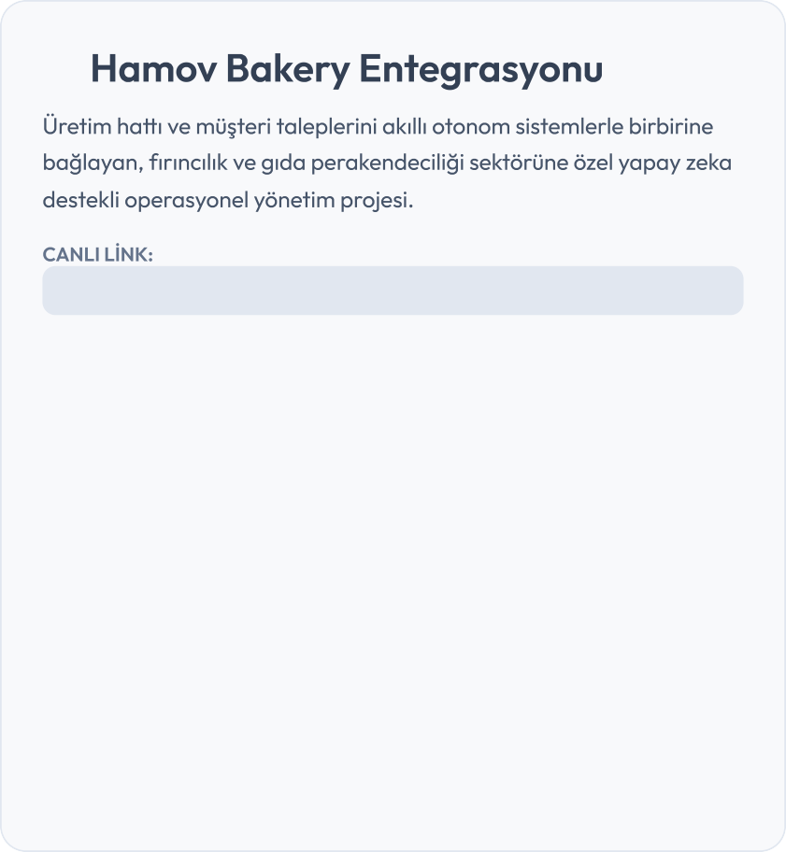
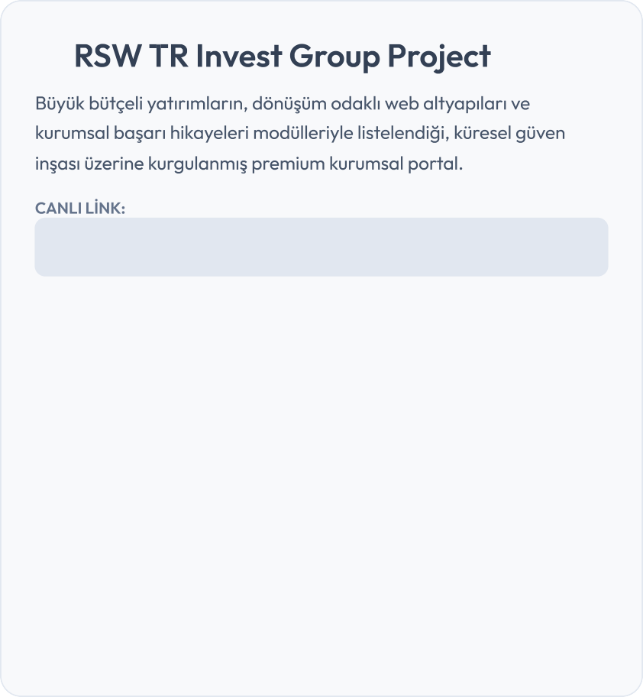
1 2m 06m 2026 06e 46
Gor Sargsyan 9 Gi obai A= & E kon om B StratejB Su n u mu
•
h b mov- b b kery- c o ec t e lovb b l e e b p p
r wtri ve tgro p - b l te gith b e io/ NE .- SI TE - PROJ E CT/#bb b ri - h i kb yeleri
fB i ee ///Ie /J sers/ASJ S/Desktop/projects/Gor su n u m/su n u m m h tm i
O/1 2

Slide 10



















1 2m 06m 2026 06e 46
Gor Sargsyar Gi obai A & E korom Stratej Su ru mu
*
* * * * *
f i ee ///#e /U sers/ASU S/Desktop/projects/Gor su ru m/su ru m m h tm i

Slide 11










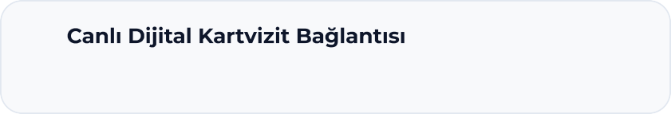

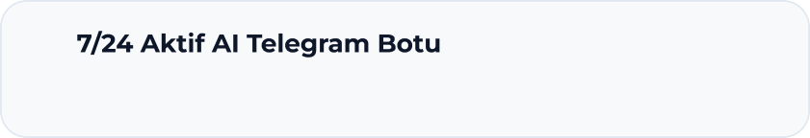
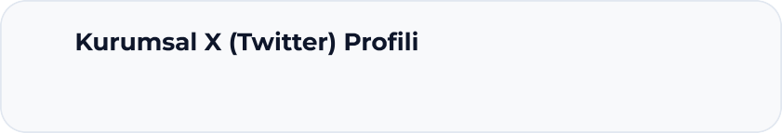
1 2m 06m 2026 06E :46
Gor Sargsyar 7 Gi obai A; & E koron@ Stratej@ Su ru nu
a
rs wtri ves tgrou p - a l tb git u b b io/ Gor_dij i ta l_ka rtvis i t/ Gor/
a
tb me/ Gor_Offl ife_ka rtvis i t_bot
:x
xb c om/ l a gu a ta a ? s = 11
f@ i eE ///GE /H sers/ASH S/Cesktop/projects/Gor su ru n/su ru nm h tni

Slide 12














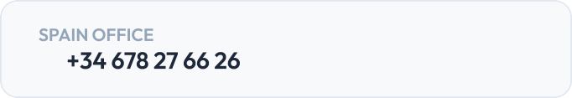
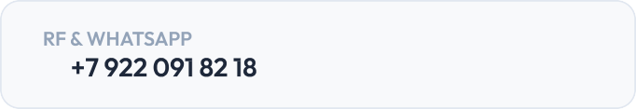
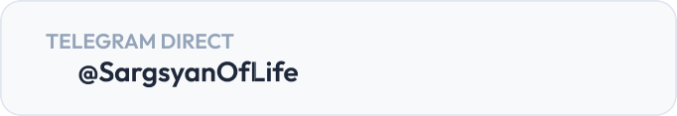



1 2m 06m 2026 06e 46
Gor Sargsyan GT obaT A & E kon om Stratej Su n u mu
f T ee ///&e /L sers/ASL S/Desktop/projects/Gor su n u m/su n u m m h tm T
1 2/1 2

